Slide 1
What is jar?
In software, JAR (Java Archive) is a package file format typically used to aggregate many Java class files and associated metadata and resources (text, images, etc.) into one file to distribute application software or libraries on the Java platform.

Slide 2
Creating a JAR File
The basic format of the command for creating a JAR file is:
jar -cvf jar-file input-file(s)
The options and arguments used in this command are:
The c option indicates that you want to create a JAR file.
The f option indicates that you want the output to go to a file rather than to stdout.
jar-file is the name that you want the resulting JAR file to have. You can use any filename for a JAR file. By convention, JAR filenames are given a .jar extension, though this is not required.
The input-file(s) argument is a space-separated list of one or more files that you want to include in your JAR file. The input-file(s) argument can contain the wildcard * symbol. If any of the "input-files" are directories, the contents of those directories are added to the JAR archive recursively.
The c and f options can appear in either order, but there must not be any space between them.

Slide 3
Examples to create jar file
jar –cvf Simple.jar A.class
jar –cvf Simple.jar A.class B.class
jar –cvf Simple.jar *.class
jar –cvf Simple.jar *.*

Slide 4
This command will generate a compressed JAR file and place it in the current directory. The command will also generate a default manifest file for the JAR archive.
Note: The metadata in the JAR file, such as the entry names, comments, and contents of the manifest, must be encoded in UTF8.

Slide 5
How to Create an executable JAR file in Java
To create an executable JAR in Java, you need to provide a manifest file and include your Main Class in Manifest.
When you create jar file , jar command also creates manifest file inside META-INF as MANIFEST.MF but doesn't create Main-Class entry which is required for executable jar file
You can create executable jar file in Java by two ways either provide a self created Manifest file or specify entry point using "-e" jar option.
If you provide external Manifest file than you need to use jar -m option to include that manifest file inside jar. Let's see example of both ways to create executable jar file in Java.

Slide 6
1. Executable JAR File Example with External Manifest
Create MANIFEST.MF file by using any text editor e.g. notepad in windows or Vim in Unix and add following entry in file
Remember last line must end with either new line or carriage return:
File name: MANIFEST.MF or MANIFEST.txt or amr.txt or amr.doc will work
Here any file name and any extension will work.
Manifest-version: 1.0 it’s optional Main-Class: HelloWorld
Note: Main-Class:HelloWorld – Invalid – There should be space after colon (before classname)
Execute following jar command to create executable jar – Here order is important
jar -cvfm HW.jar MANIFEST.MF HelloWorld.class
Or
jar -cvmf MANIFEST.MF HW.jar HelloWorld.class
here -m is used for including manifest file and remember specify name of manifest file after jar name. now you have an executable jar file in java which you run by command specified earlier.

Slide 7
When java.io.IOException: invalid header field?
When running the below command :
jar cvfm myjar.jar manifest.mf *.class
Below Exception may occurred.
java.io.IOException: invalid header field
at java.util.jar.Attributes.read(Attributes.java:410)
at java.util.jar.Manifest.read(Manifest.java:199)
at java.util.jar.Manifest.<init>(Manifest.java:69)
at sun.tools.jar.Main.run(Main.java:171)
at sun.tools.jar.Main.main(Main.java:1176)
Root cause: There's a problem with manifest file.
see if there is any typo in the file

Slide 8
2. Creating Executable JAR File By entry point
This seems to me an easy way to create executable jars in Java, as you need not have to create manifest file explicitly and it will be create by jar command itself along with Main-Class entry. What you need to provide is a new jar option "-e" and you main class name while running jar command. here is example of jar command with entry option:
jar -cvfe jarfilename.jar Mainclass-name inputfilenames
Eg: jar –cvfe HW.jar HelloWorld *.class
jar -e for entry point and entry point or main class name should come after jar file name and before directory or file needs to be included in JAR. You can now run your executable jar file by issuing "java -jar" command as shown in following

Slide 9
How to execute jar file
Executing jar program from jar archive is very easy one thing required is jar must be executable and must have Main-Class entry in MANIFEST.MF file. here is a Java command example for running java program from jar file:
java -jar HW.jar
Don’t forget to add - (hyphen) before jar command here
Java jar HW.jar (invalid) – gives NoClassDefFoundError

Slide 10
How to extract contents of JAR File
use jar option "-x" for extracting files form JAR files as shown in jar command example below: jar -xvf jarfilename.jar

Slide 11
How to view contents of a JAR file in Java
jar command in Java allows you to view files and directories inside of a jar file without extracting or unzipping original jar. "-t" jar option is used to list files from jar archive as shown in jar command example below
jar -tvf HelloWorld.jar

Slide 12
JAR File format in Java
Few words about java jar file format, its similar to zip format and use .jar extension. you can open JAR file in windows by using either winzip or winrar zip utilities.

Slide 13
Eclipse - Create Jar Files

Slide 14
Opening the Jar File wizard
The Jar File wizard can be used to export the content of a project into a jar file.
To bring up the Jar File wizard:
In the Package Explorer select the items that you want to export. If you want to export all the classes and resources in the project just select the project.
Click on the File menu and select Export.
In the filter text box of the first page of the export wizard type in "JAR".

Slide 15
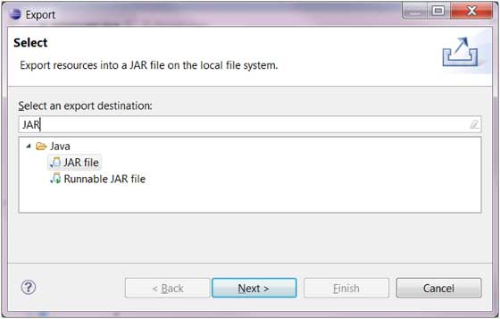
Under the Java category select JAR file Click on Next

Slide 16
Using the Jar File wizard
In the JAR File Specification page:
Enter the JAR file name and folder
The default is to export only the classes. To also export the source code Click on the "Export Java source files and resources" check box.

Slide 17
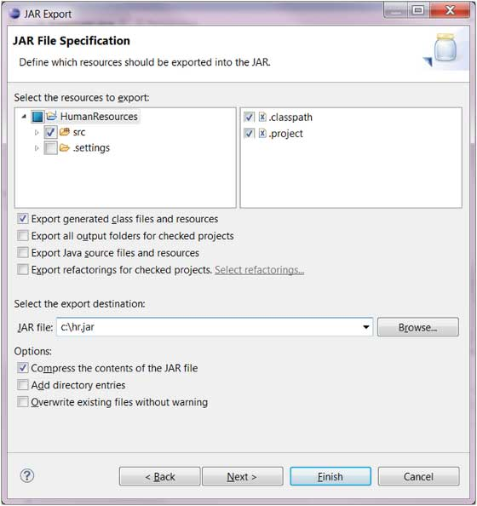
Click on Next to change the JAR packaging options Click on Next to change the JAR Manifest specification Click on Finish

Slide 18
Jar vs War Vs Ear
jar – java archive
JAR files are used in J2EE for packaging EJBs and client-side Java Applications.
A JAR file encapsulates one or more Java classes, a manifest, and a descriptor.
EJB modules which contain enterprise java beans (class files) and EJB deployment descriptor are packed as JAR files with .jar extension
war - web archive.
WAR file in Java stands for Web application archive and it is used to package a Java application together you can package all your Servlet, JSP, CSS, images, html in one WAR file and then deploy it to any Java web or application server like Tomcat, Weblogic or webshere. WAR files provide a clean and faster way to package and deploy Java web application just like JAR file provides for core java apps. Since WAR file also compacts resources inside it is comparatively download faster than downloading individual components.
ear - enterprise archive. (*.jar + *.war)
EAR file stands for Enterprise Java Archive and used to package an Enterprise Java application, like earlier WAR and JAR file. What separates EAR archive to WAR file is inclusion of Enterprise Java Beans(EJB). EAR file contains all web resources including Servlet, JSP, html, javascript, css, images along-with EJB. You can not deploy EAR files into web servers like Tomcat because it doesn't support EJB and can only be deploy-able in Application servers like WebSphere or Weblogic.

